Slide 1





Fully Automated Functional Fuzzing of Android Apps for Detecting Non-crashing Logic Bugs
Ting Su*, Yichen Yan, Jue Wang, Jingling Sun, Yiheng Xiong,
Geguang Pu, Ke Wang, Zhendong Su
SPLASH/OOPSLA 2021
*This work was mainly conducted when Ting Su was a postodc at ETH Zurich.

Slide 2
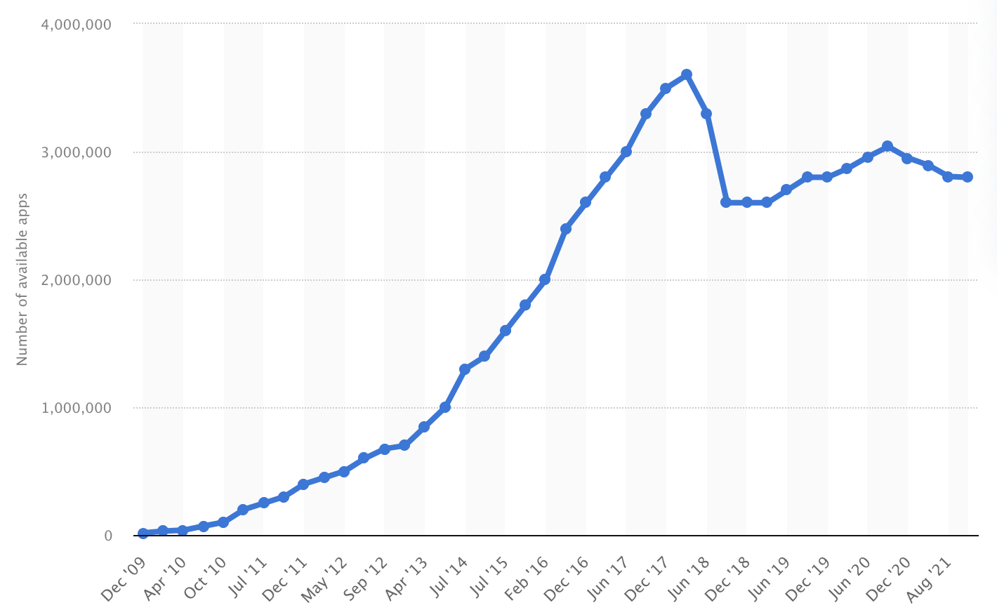
#Android Apps in the Google Play Store (from December 2009 to August 2021)
https://www.statista.com/statistics/266210/number-of-available-applications-in-the-google-play-store/

Slide 3
#Android Apps in the Google Play Store (from December 2009 to August 2021)
3 millions
https://www.statista.com/statistics/266210/number-of-available-applications-in-the-google-play-store/

Slide 4
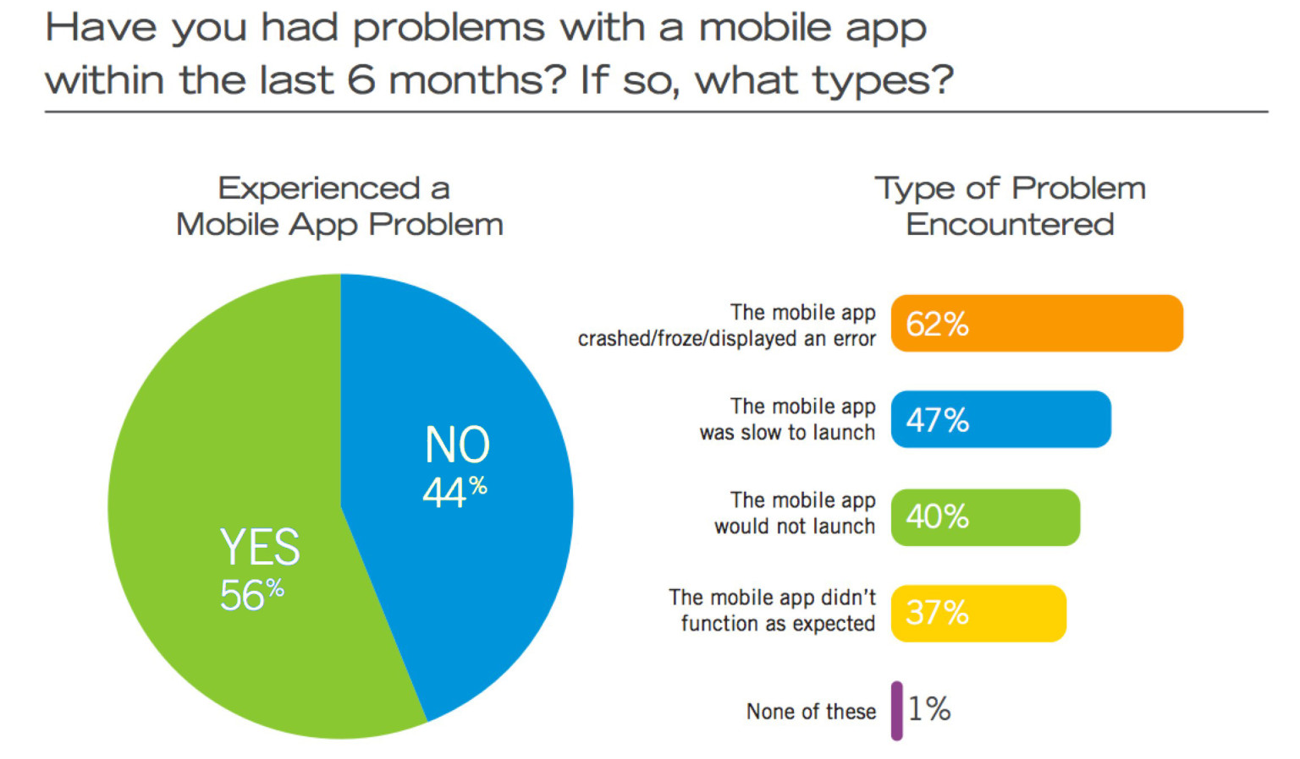
Issues are Common for Mobile Apps
Mobile Apps: What Consumers Really Need and Want. Compuware 2016
https://silo.tips/download/mobile-apps-what-consumers-really-need-and-want-a-global-study-of-consumers-expe

Slide 5
Issues are Common for Mobile Apps
Mobile Apps: What Consumers Really Need and Want. Compuware 2016
https://silo.tips/download/mobile-apps-what-consumers-really-need-and-want-a-global-study-of-consumers-expe

Slide 6
Issues are Common for Mobile Apps
Crash bugs
Mobile Apps: What Consumers Really Need and Want. Compuware 2016
https://silo.tips/download/mobile-apps-what-consumers-really-need-and-want-a-global-study-of-consumers-expe

Slide 7

Issues are Common for Mobile Apps
Non-crashing
functional bugs
Mobile Apps: What Consumers Really Need and Want. Compuware 2016
https://silo.tips/download/mobile-apps-what-consumers-really-need-and-want-a-global-study-of-consumers-expe

Slide 8
Existing Solutions Do Not Work Well
Manual testing
Tools: Espresso, Robotium, Appium, ……
Expensive and small-scale, lack of automation (require writing UI tests/oracles)
Modern fully automated GUI testing
Tools: Monkey, Sapienz[ISSTA’16], Stoat[ESEC/FSE’17], APE[ICSE’19], ……
Limited to crash bugs, lack of test oracles
Static program analysis
Tools: Lint, FindBugs, SonarQube, Infer, ……
Difficult to find app-specific non-crashing logic errors

Slide 9
Our Approach: Independent View Fuzzing
Given an app, our approach
automatically detects non-crashing bugs without requiring human-provided tests and oracles; and
detected bugs are diverse and not limited to specific functional properties.

Slide 10
Our Approach: Independent View Fuzzing
Given an app, our approach
automatically detects non-crashing bugs without requiring human-provided tests and oracles; and
detected bugs are diverse and not limited to specific functional properties.
Our implementation Genie
Evaluated on 12 real-world Android apps;
Found 34 non-crashing bugs (all have been confirmed, 22 were already fixed)
Open-sourced at:
https://github.com/functional-fuzzing-android-apps/home

Slide 11
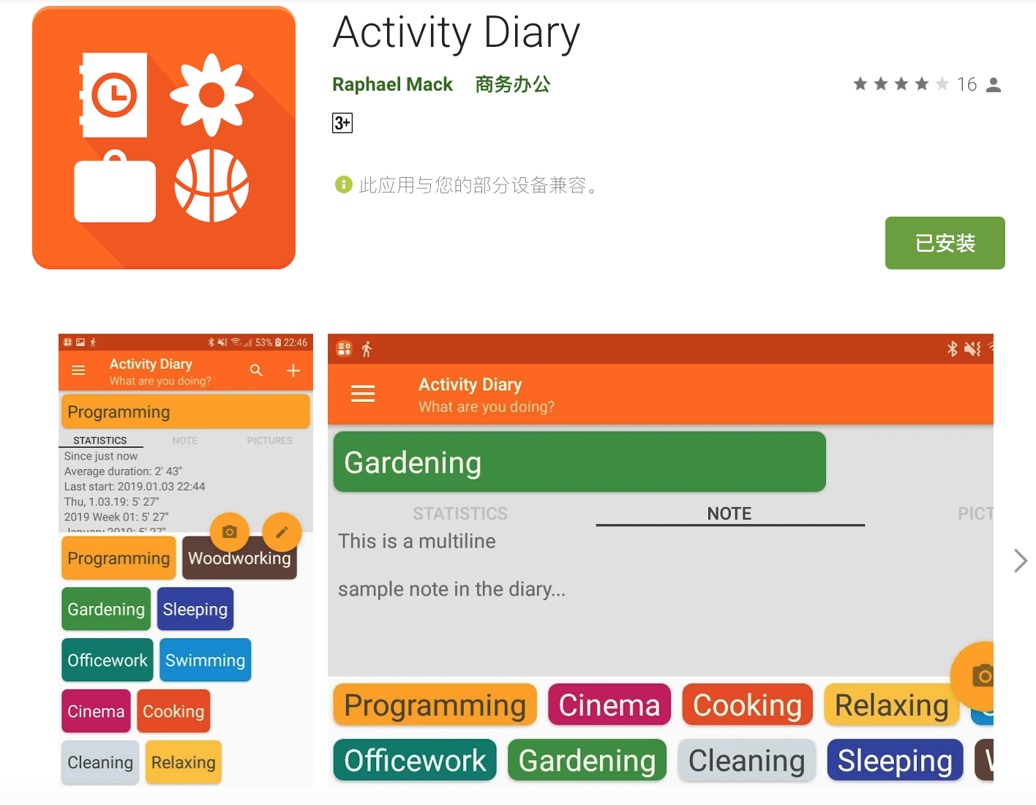
A Real Non-crashing Functional Bug in ActivityDiary
A diary app for daily activities
v1.18
Issue link: https://github.com/ramack/ActivityDiary/issues/118

Slide 12
A Normal Usage Scenario (Scenario I)

Slide 13
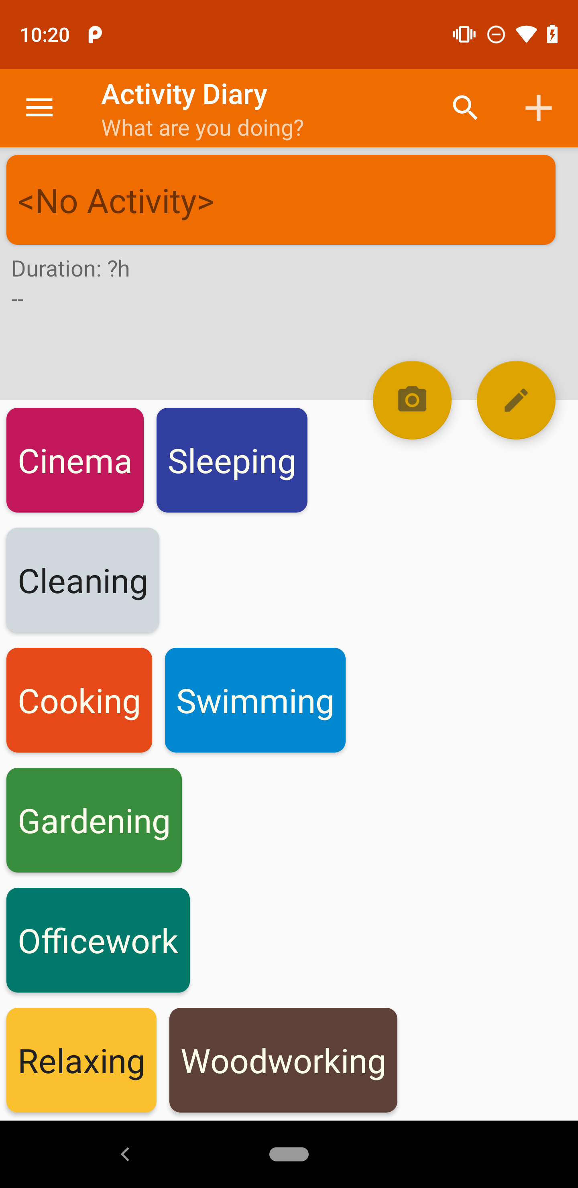
Scenario I: Start the app

Slide 14
Scenario I: click “Officework”

Slide 15
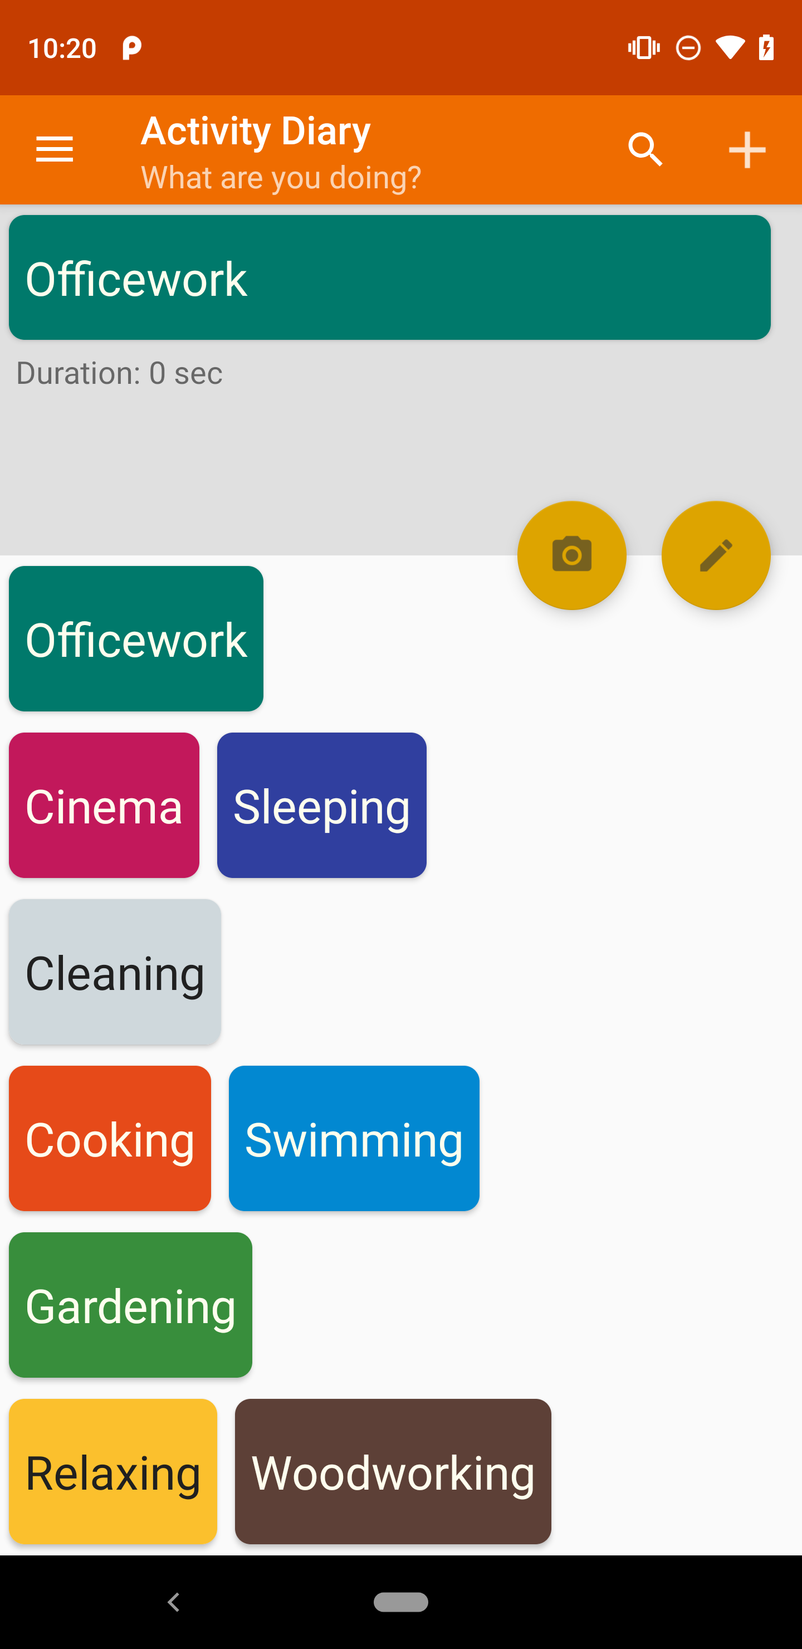
Scenario I:

Slide 16
Scenario I: click “Camera”

Slide 17
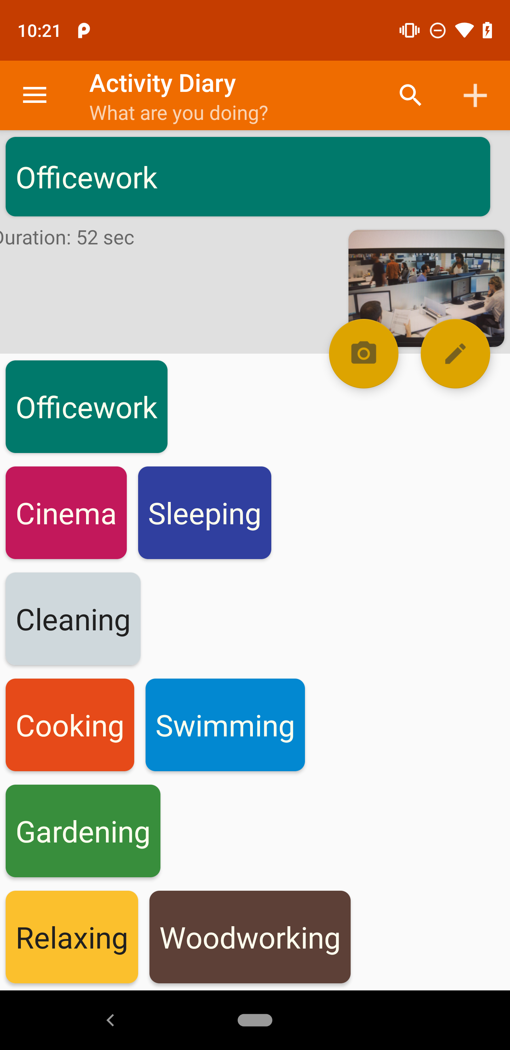
Scenario I:

Slide 18
Scenario I: navigate to sidebar

Slide 19
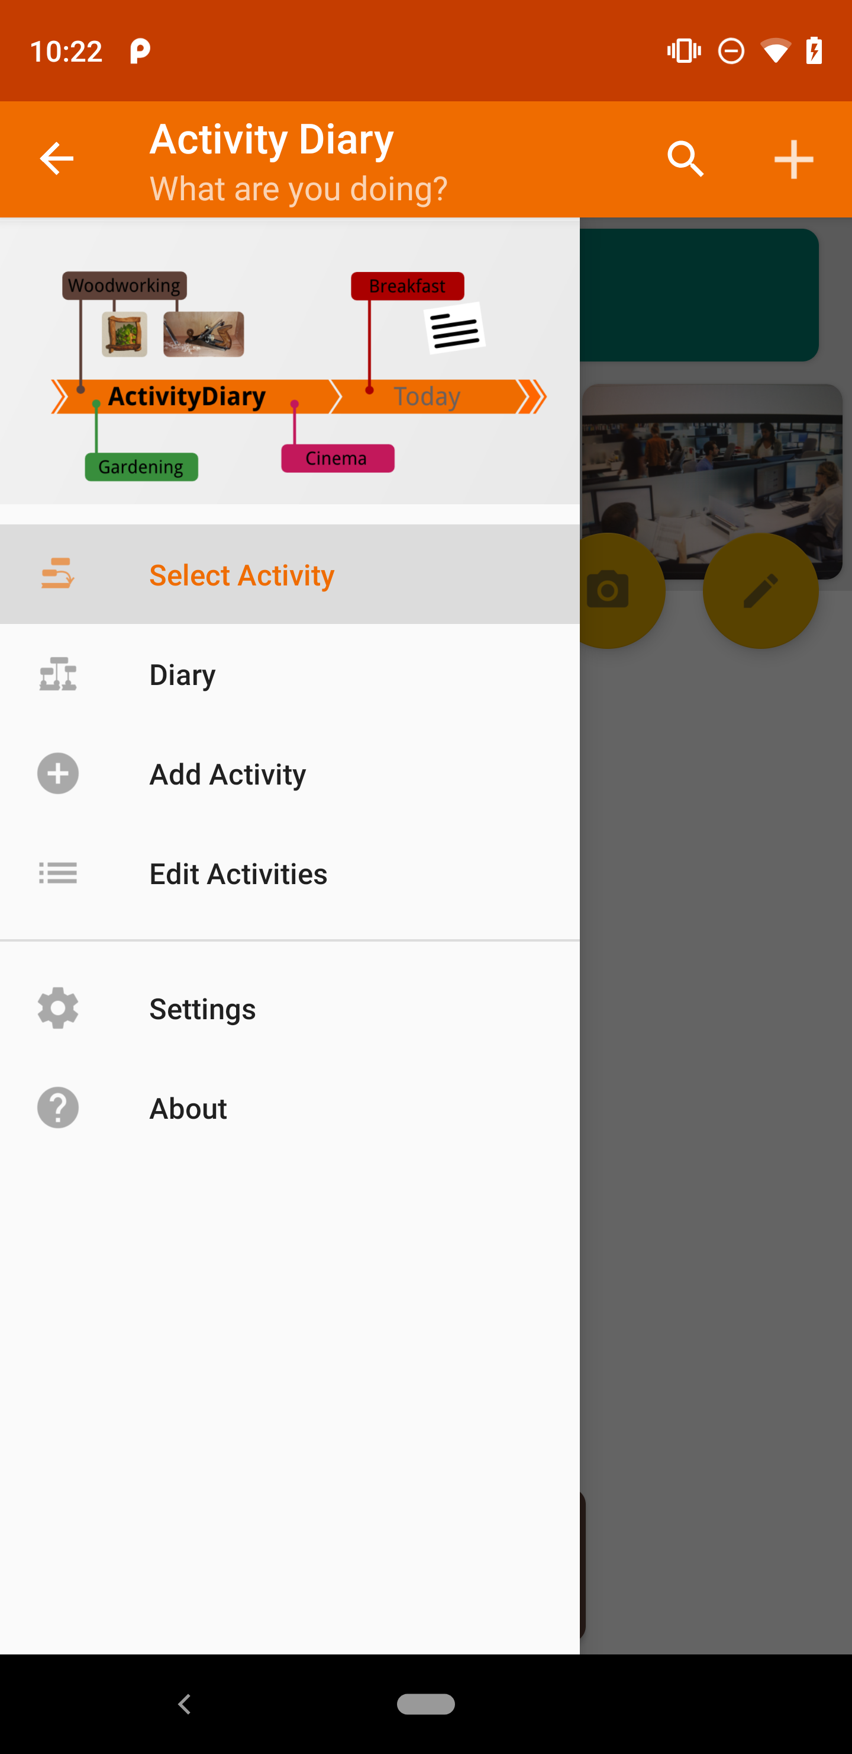
Scenario I:

Slide 20
Scenario I: choose “Diary”

Slide 21
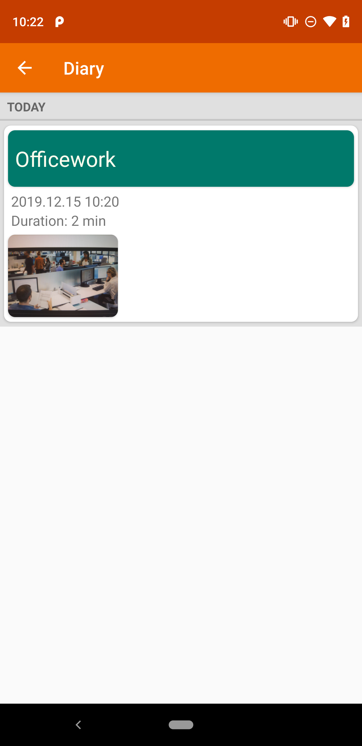
Scenario I:

Slide 22
Scenario I: long-touch
Officework’s Picture

Slide 23
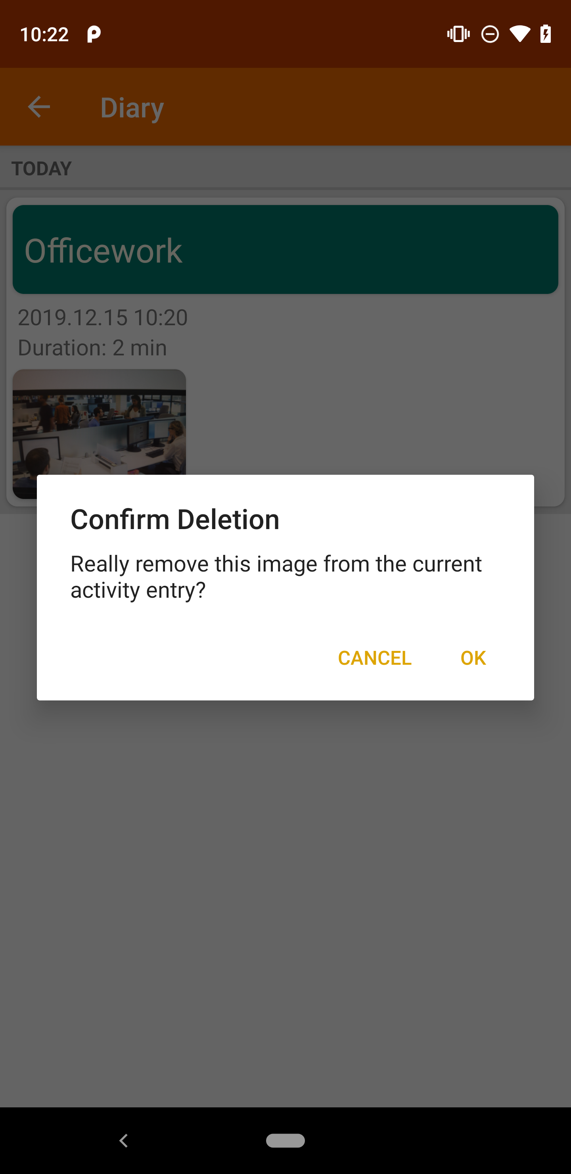
Scenario I:

Slide 24
Scenario I: click “OK”

Slide 25
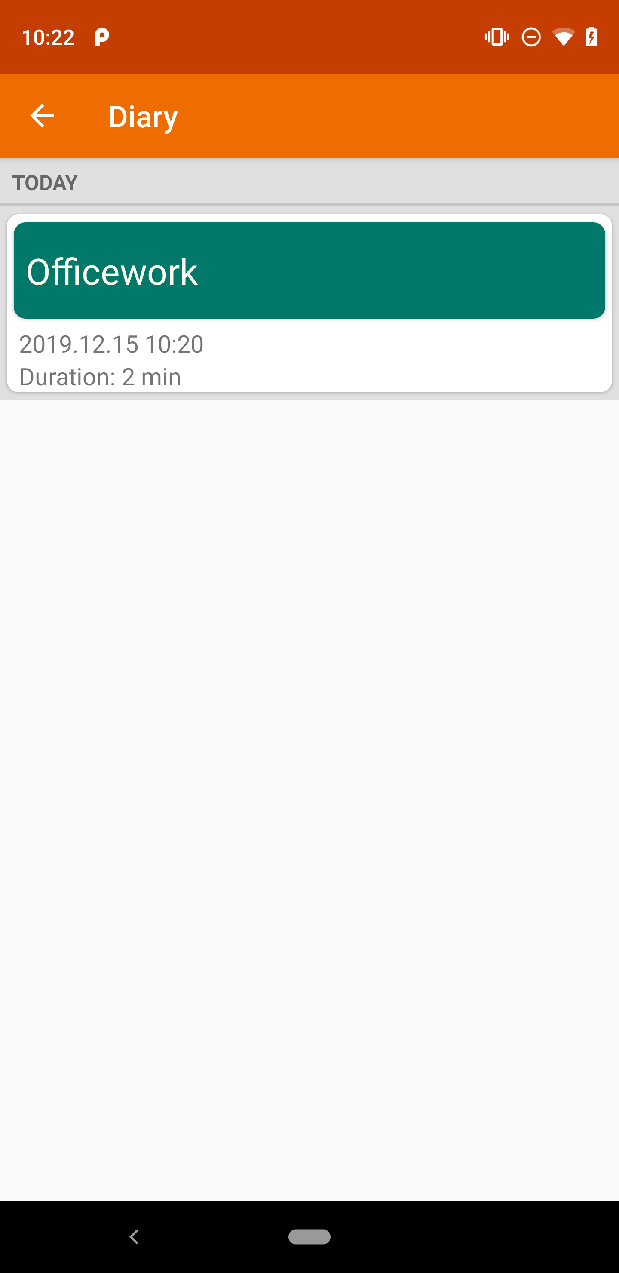
Scenario I:
(Officework’s picture is deleted)

Slide 26
A Buggy Usage Scenario (Scenario II)

Slide 27
Scenario II: Start the app

Slide 28
Scenario II: click “Officework”

Slide 29
Scenario II:

Slide 30
Scenario II: click “Camera”

Slide 31
Scenario II:

Slide 32
Scenario II: click “Cooking”

Slide 33
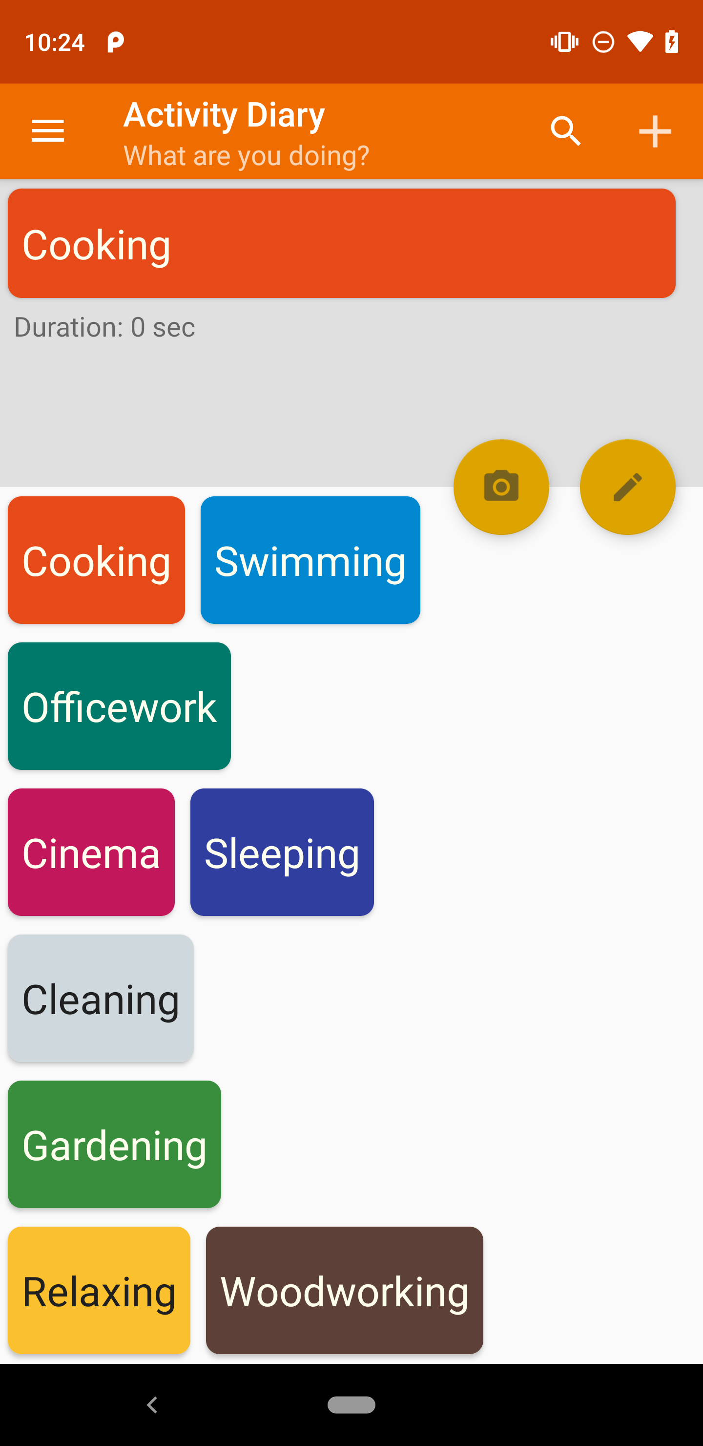
Scenario II:

Slide 34
Scenario II: click “Camera”

Slide 35
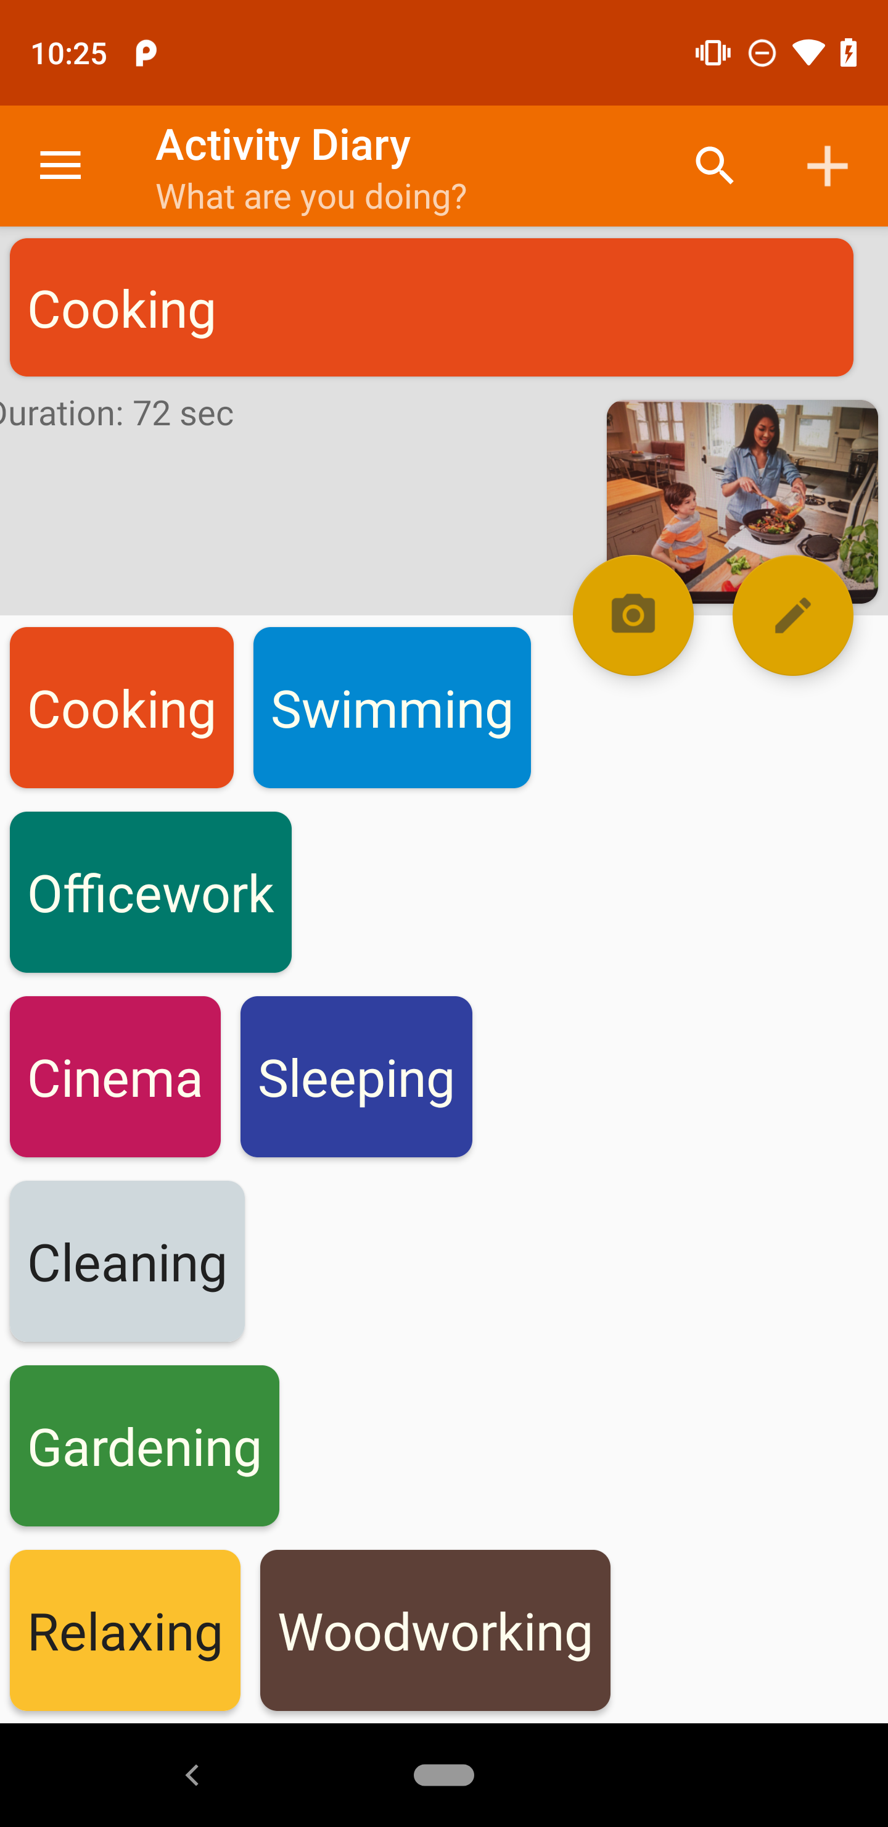
Scenario II:

Slide 36
Scenario II: navigate to sidebar

Slide 37
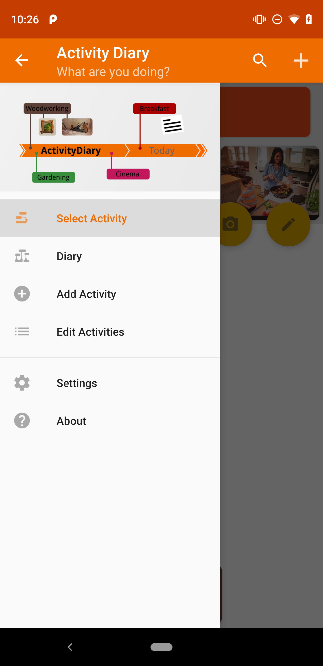
Scenario II:

Slide 38
Scenario II: choose “Diary”

Slide 39
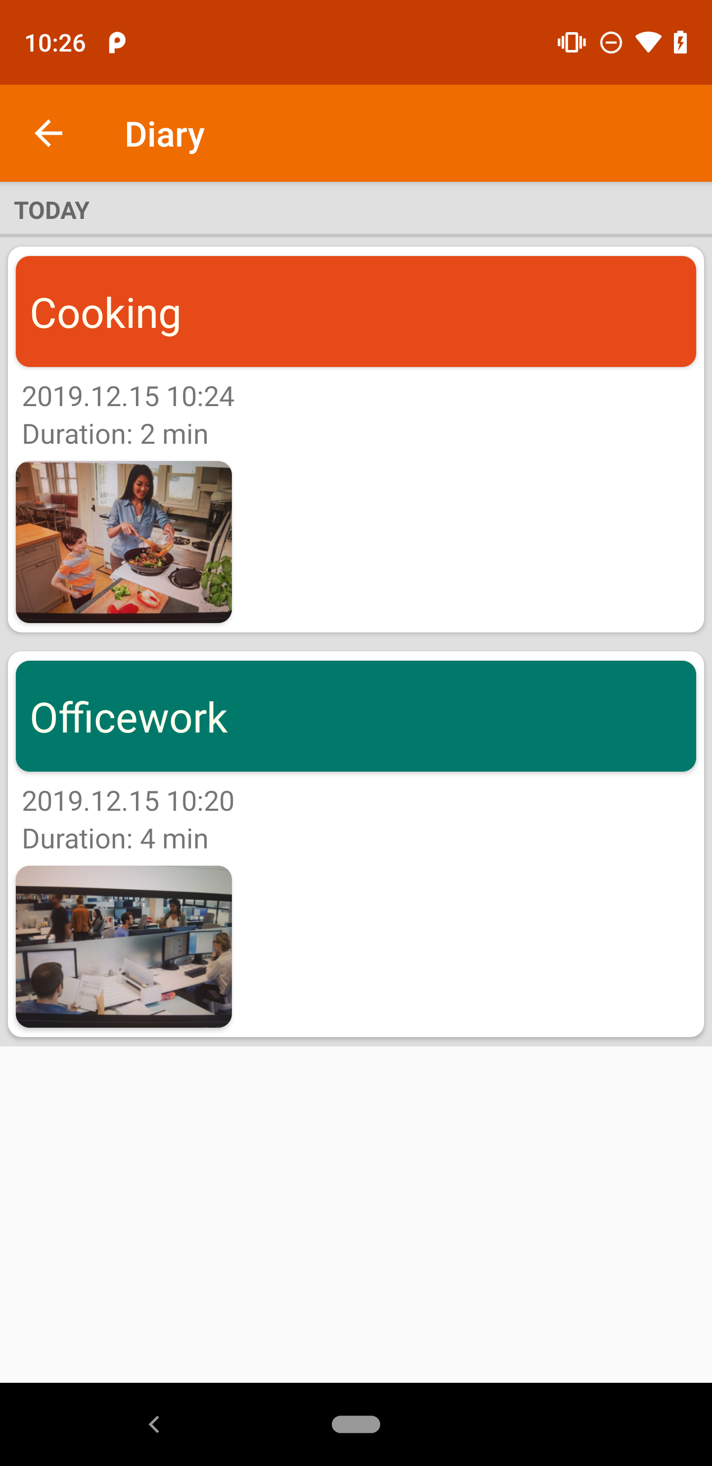
Scenario II:

Slide 40
Scenario II: long-touch
Officework’s Picture

Slide 41
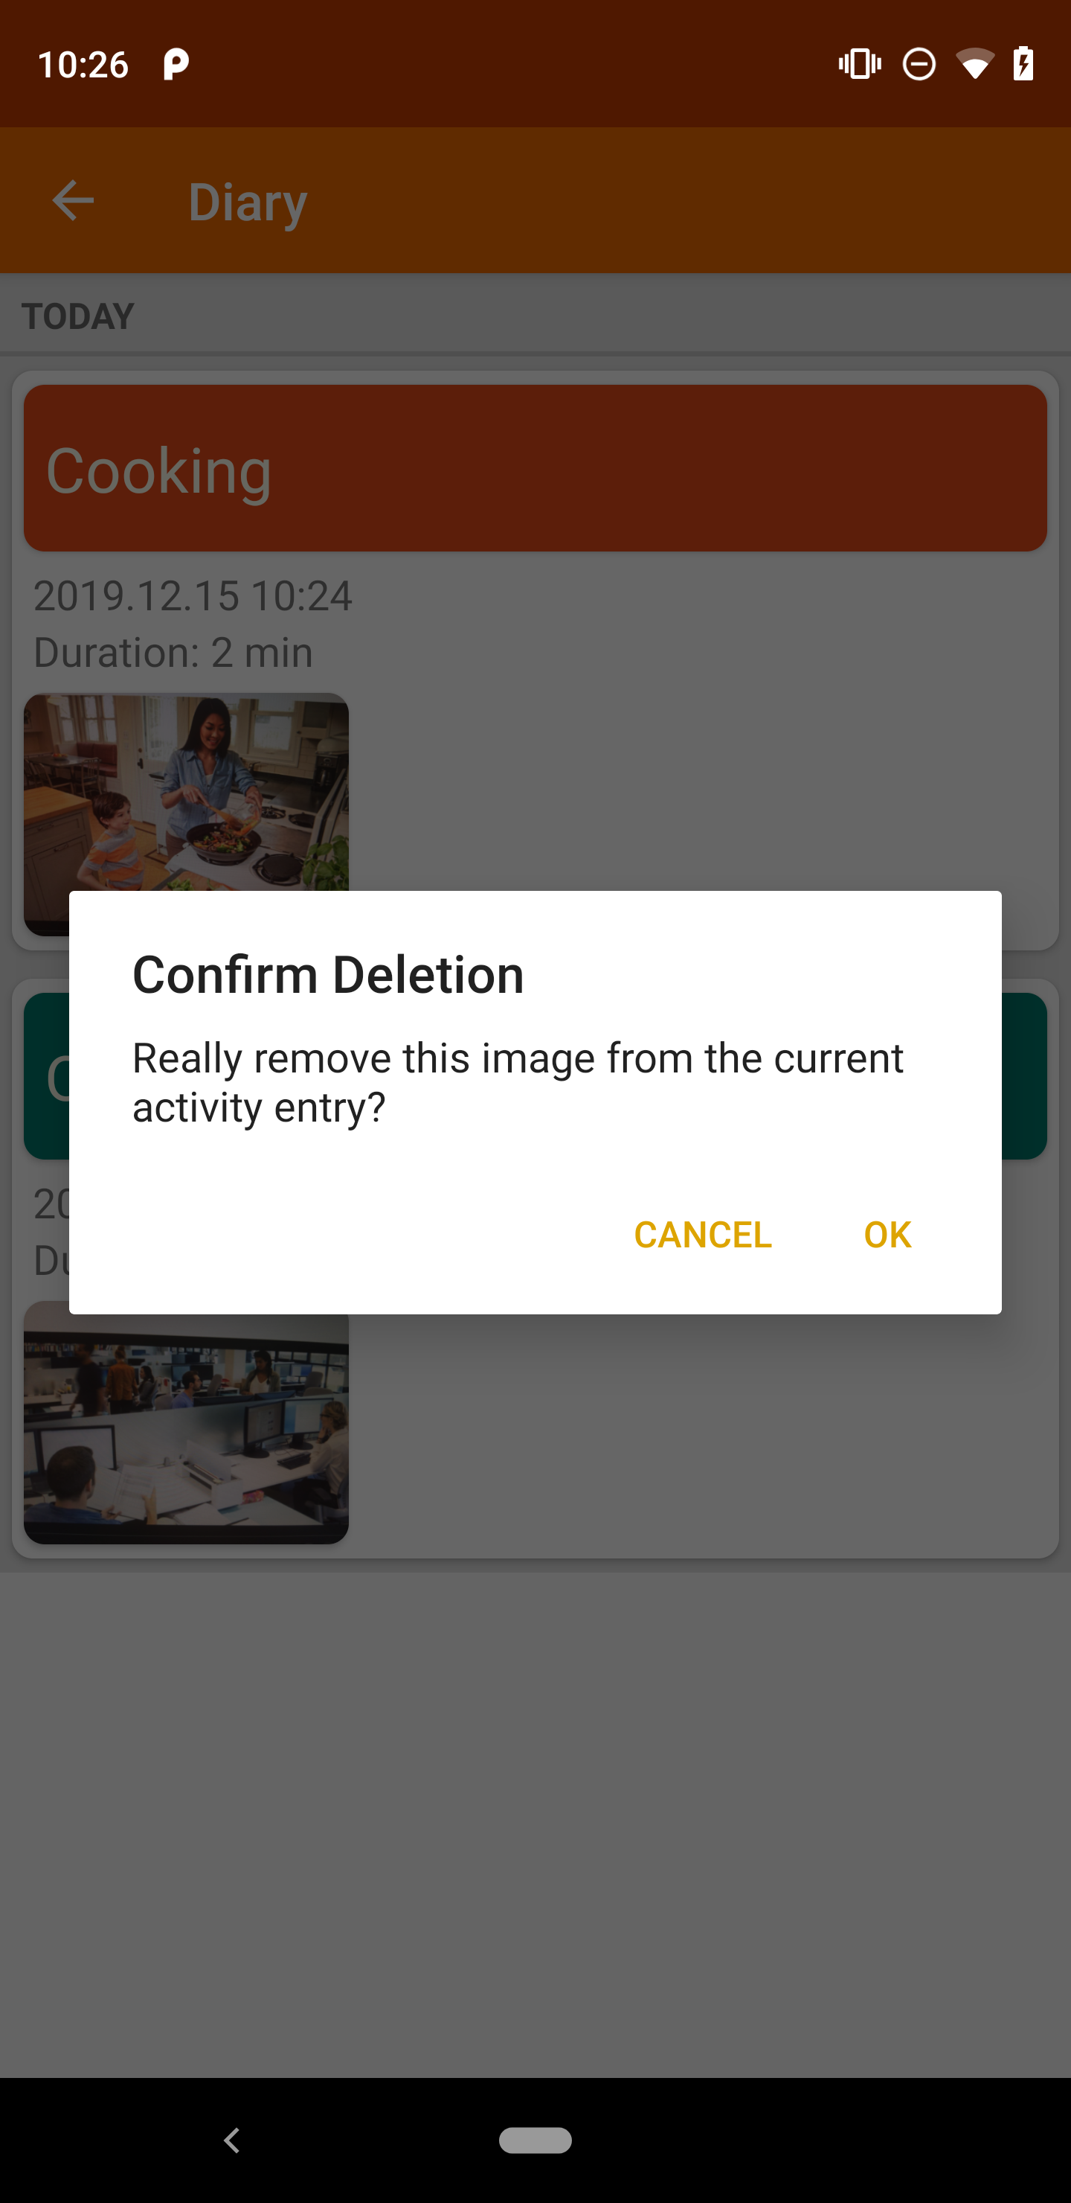
Scenario II:

Slide 42
Scenario II: click “OK”

Slide 43
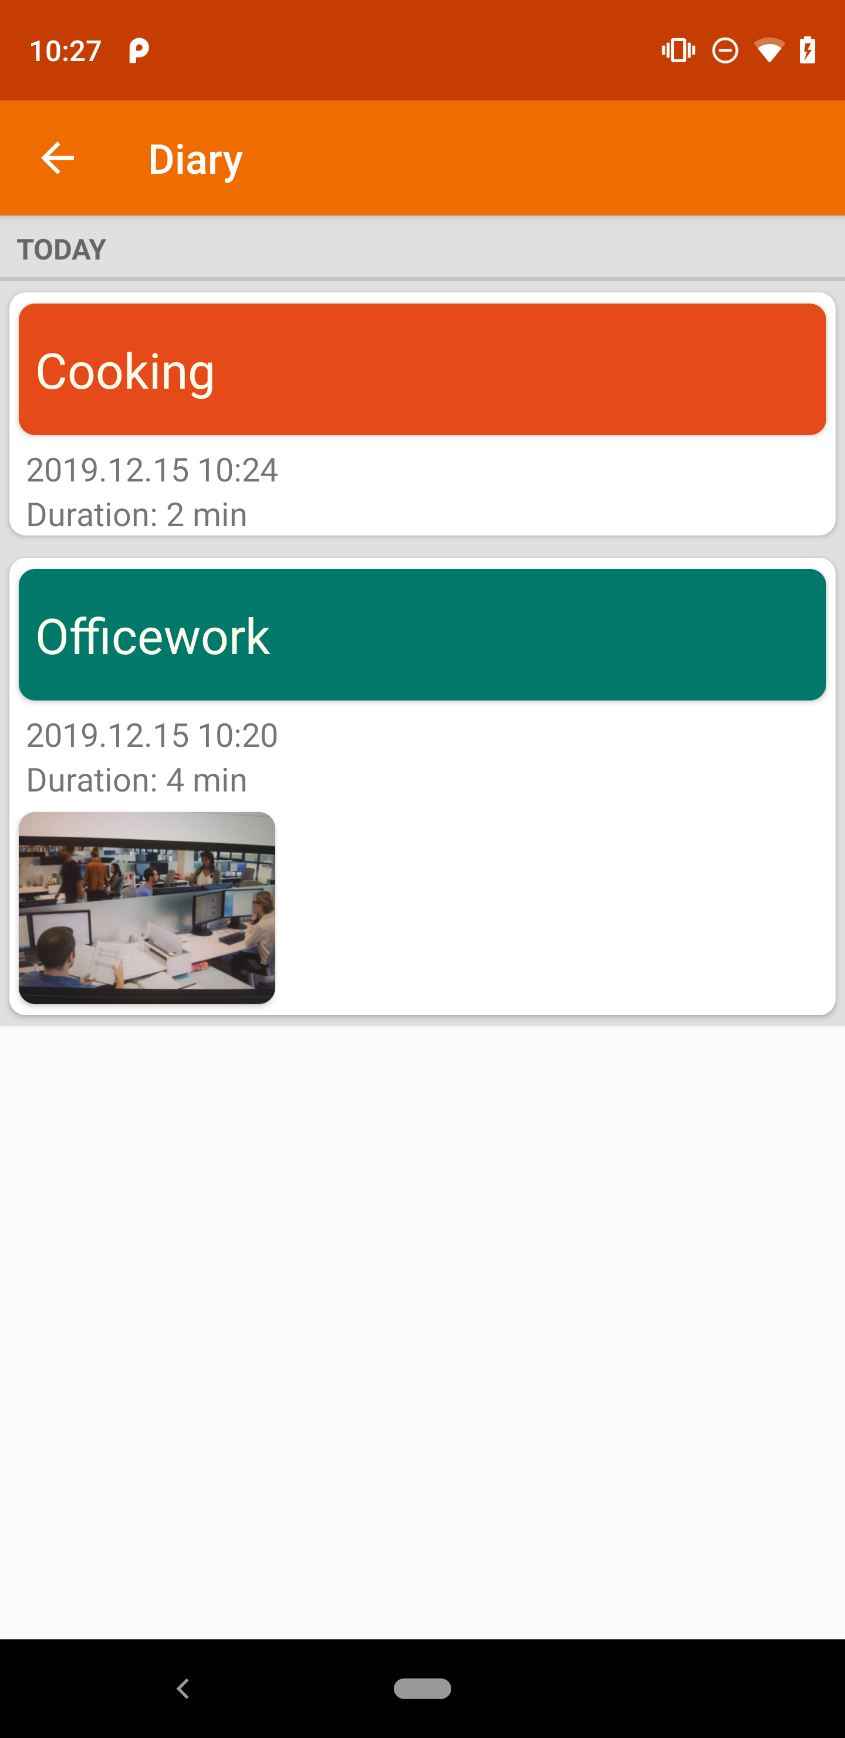
Scenario II:
(Cooking’s picture is deleted)

Slide 44
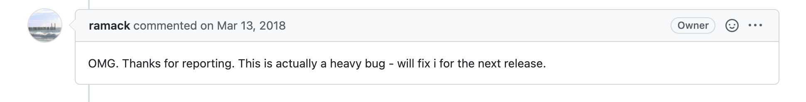
Scenario II:
(Cooking’s picture is deleted)
Issue link: https://github.com/ramack/ActivityDiary/issues/118

Slide 45
Our observation: Independent View Property
Many apps hold independent view property
Interacting with one GUI view (widget) does not affect the states of others and only add, but not remove additional GUI effects

Slide 46
Independent View Property

Slide 47
Independent View Property

Slide 48
Independent View Property

Slide 49
Independent View Property

Slide 50
Independent View Property

Slide 51
Independent View Property
“Officework” and “Cooking” are independent views because they are siblings in a ListView

Slide 52
Independent View Property
Independent Event Traces

Slide 53
…
Scenario I

Slide 54
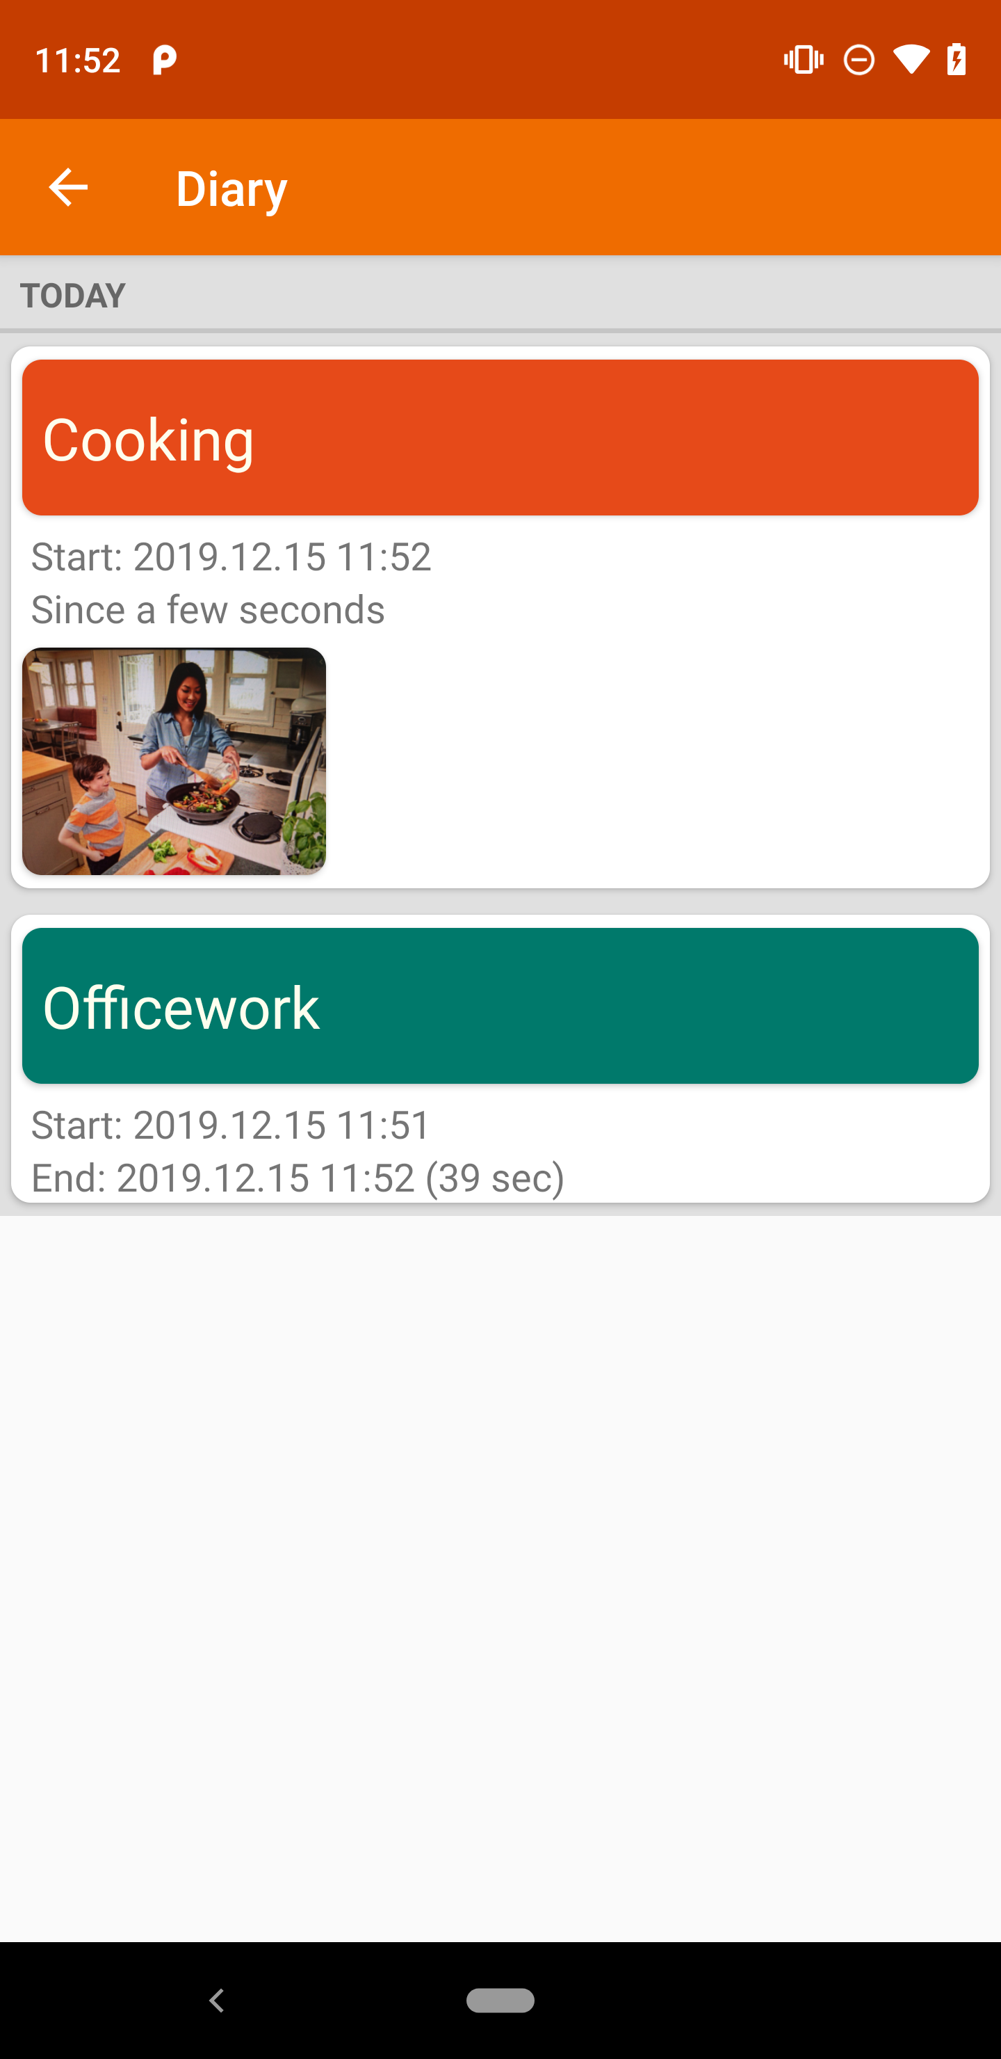
…
Scenario I
…
Scenario II
(Expected
behavior)

Slide 55
…
Scenario I
only add additional GUI effects
…
Scenario II
(Expected
behavior)

Slide 56
Our observation: Independent View Property
Many apps hold independent view property
Interacting with one GUI view (widget) does not affect the states of others and only add, but not remove additional GUI effects

Slide 57
Our observation: Independent View Property
Many apps hold independent view property
Interacting with one GUI view (widget) does not affect the states of others and only add, but not remove additional GUI effects
Our insight: Inspired by metamorphic testing, our key insight is to mutate a seed test by injecting independent event traces; and check the GUI effects before and after the insertion position.

Slide 58
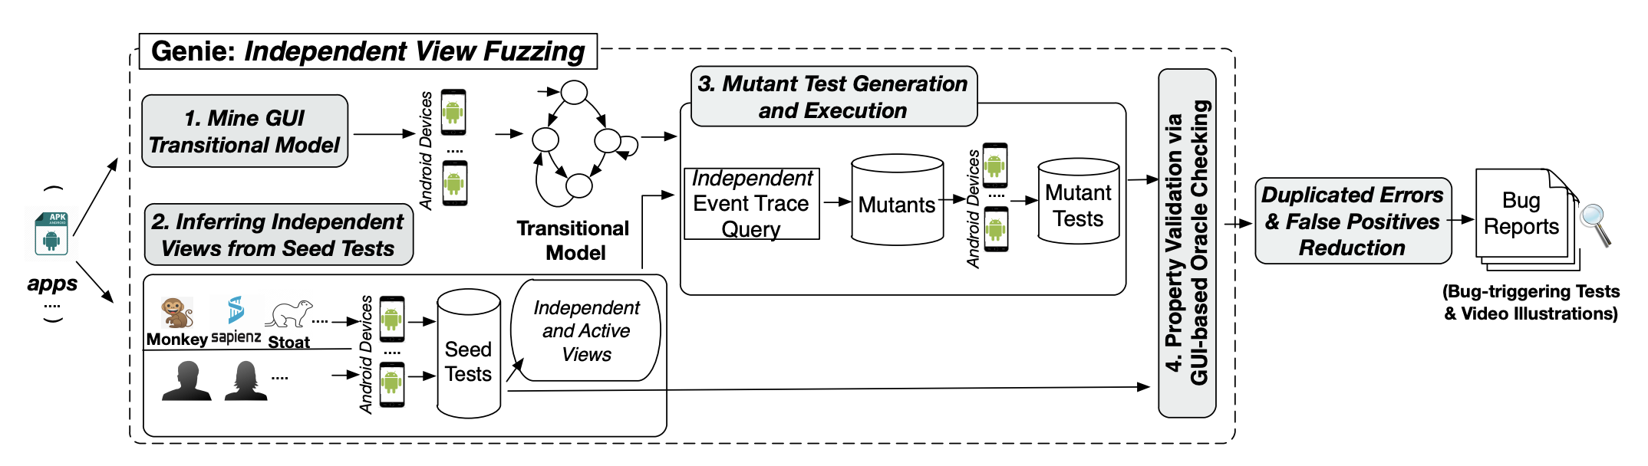
Genie’s Workflow

Slide 59
Genie’s Workflow

Slide 60
Step 1: Mine GUI Transitional Model

Slide 61
Step 1: Mine GUI Transitional Model

Slide 62
Step 1: Mine GUI Transitional Model

Slide 63
Genie’s Workflow

Slide 64
Genie’s Workflow

Slide 65
Step 2: Inferring Independent Views from Seeds

Slide 66
𝓁₁
𝓁₂
𝓁₃
Seed Test
Executed view
𝓁₄
𝓁₅
𝓁₆

Slide 67
𝓁₁
𝓁₂
𝓁₃
Seed Test
Executed view
Active view
𝓁₄
𝓁₅
𝓁₆

Slide 68
𝓁₁
𝓁₂
𝓁₃
Seed Test
Executed view
Active view
Group view
(e.g., ListView, RecyclerView)
(Inactive) Independent
views
𝓁₄
𝓁₅
𝓁₆

Slide 69
Genie’s Workflow

Slide 70
Genie’s Workflow

Slide 71
𝓁₁
𝓁₂
𝓁₃
Seed Test
Executed view
Active view
Group view
(e.g., ListView, RecyclerView)
(Inactive) Independent
views
𝓁₄
𝓁₅
𝓁₆

Slide 72
𝓁₁
𝓁₂
𝓁₃
Seed Test
Executed view
Active view
Group view
(e.g., ListView, RecyclerView)
(Inactive) Independent
views
𝓁₄
𝓁₅
𝓁₆

Slide 73
𝓁₁
𝓁₂
𝓁₃
Generated Mutant Test
𝓁₄
𝓁₅
𝓁₆

Slide 74
𝓁₁
𝓁₂
𝓁₃
Generated Mutant Test
𝓁₄
𝓁₅
𝓁₆

Slide 75
Model-based Independent Event Trace Query

Slide 76
Model-based Independent Event Trace Query
(s₁)
𝓁₃

Slide 77
Model-based Independent Event Trace Query
(s₀)
(s₁)
𝓁₃

Slide 78
Model-based Independent Event Trace Query
(s₀)
(s₁)
(s₁)
𝓁₃

Slide 79
𝓁₁
𝓁₂
𝓁₃
Generated Mutant Test
𝓁₄
𝓁₅
𝓁₆

Slide 80
𝓁₁
𝓁₂
𝓁₃
Executed Mutant Test
𝓁₄’
𝓁₅’
𝓁₆’

Slide 81
Genie’s Workflow

Slide 82
Genie’s Workflow

Slide 83
GUI-based Oracle Checking

Slide 84
GUI-based Oracle Checking

Slide 85
GUI-based Oracle Checking
⊄
Likely bugs

Slide 86
⊄
Likely bugs
𝓁₄
𝓁₅
𝓁₆
𝓁₄’
𝓁₅’
𝓁₆’

Slide 87
⊄
Likely bugs
𝓁₄
𝓁₅
𝓁₆
= {(Officework’s pic, ⊥)}
𝓁₄’
𝓁₅’
𝓁₆’

Slide 88
⊄
Likely bugs
𝓁₄
𝓁₅
𝓁₆
= {(Officework’s pic, ⊥)}
= {(Cooking’s pic, ⊥)}
𝓁₄’
𝓁₅’
𝓁₆’

Slide 89
⊄
Likely bugs
𝓁₄
𝓁₅
𝓁₆
= {(Officework’s pic, ⊥)}
= {(Cooking’s pic, ⊥)}
∆ ⊄∆’
𝓁₄’
𝓁₅’
𝓁₆’

Slide 90
Research Questions
RQ1: Can Genie automatically find non-crashing functional bugs in real apps?
RQ2: Can Genie improve code coverage via functional fuzzing?
RQ3: How is Genie’s precision in finding non-crashing functional bugs?
RQ4: What types/characteristics of non-crashing bugs can Genie find?

Slide 91
Research Questions
RQ1: Can Genie automatically find non-crashing functional bugs in real apps?
RQ2: Can Genie improve code coverage via functional fuzzing?
RQ3: How is Genie’s precision in finding non-crashing functional bugs?
RQ4: What types/characteristics of non-crashing bugs can Genie find?

Slide 92
Evaluation Setup
App subjects: 12 real-world Android apps
>10,000 installations AND >100 stars
>2-year active maintenance
Self-contained

Slide 93
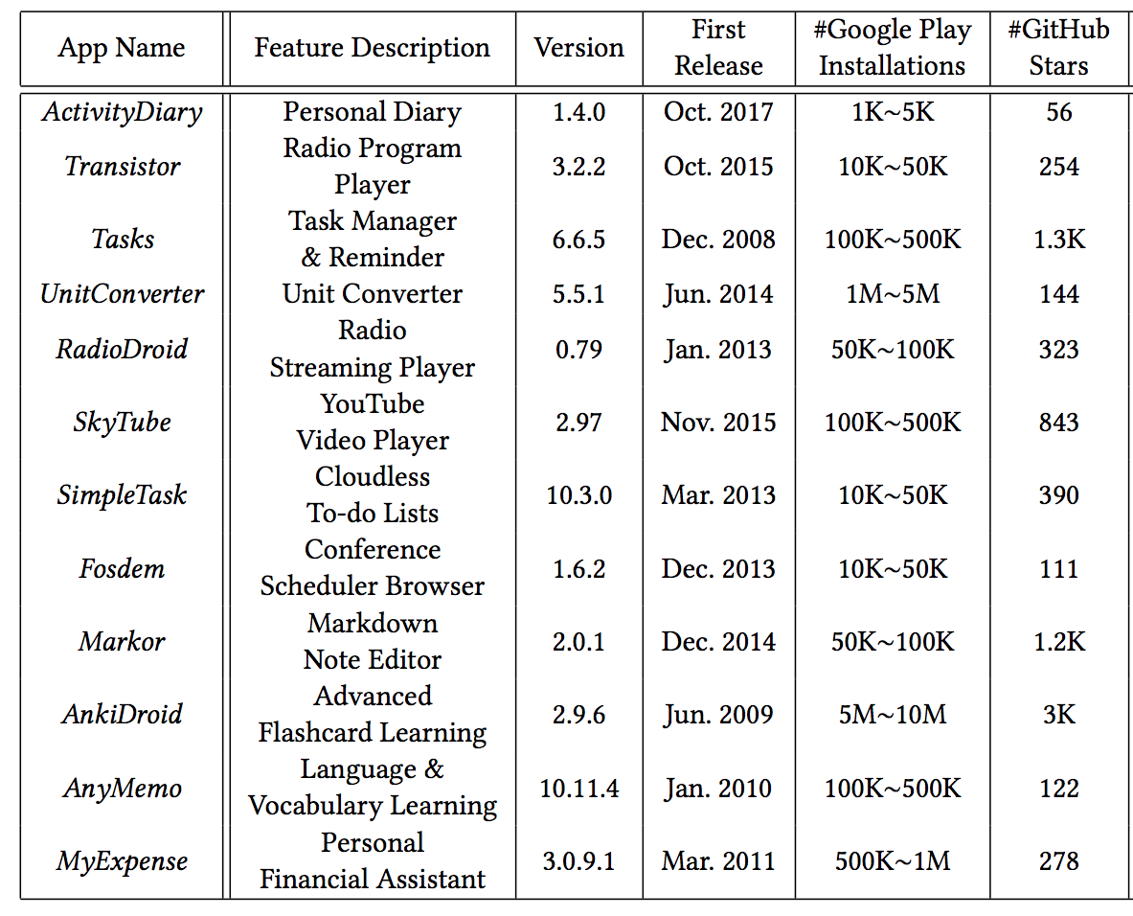

Slide 94
Diverse app categories

Slide 95
Actively maintained for long time

Slide 96
Real-world and popular

Slide 97
We tested the latest release versions of these apps

Slide 98
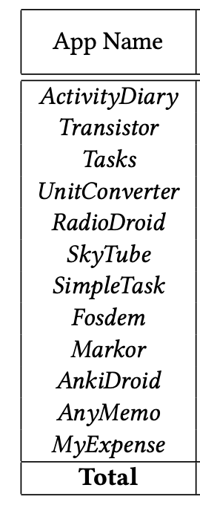
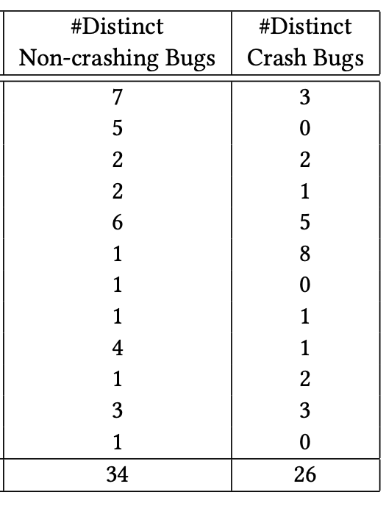
RQ1: Bugs found by Genie

Slide 99
RQ1: Bugs found by Genie
Genie is able to find non-crash functional bugs in each of the 12 apps.

Slide 100
RQ1: Bugs found by Genie
As a by-product of our testing, Genie also found some crash bugs.

Slide 101
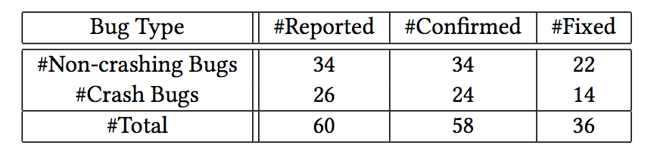
RQ1: Bugs found by Genie

Slide 102
RQ1: Bugs found by Genie
In total, Genie found 34 non-crashing bugs, all of which have been confirmed and 22 were already fixed.

Slide 103
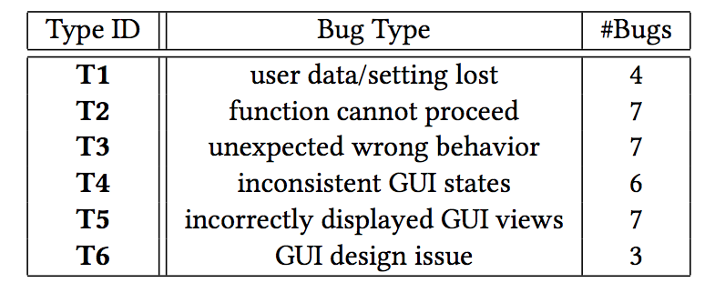
RQ4: Bug Types/Characteristics

Slide 104
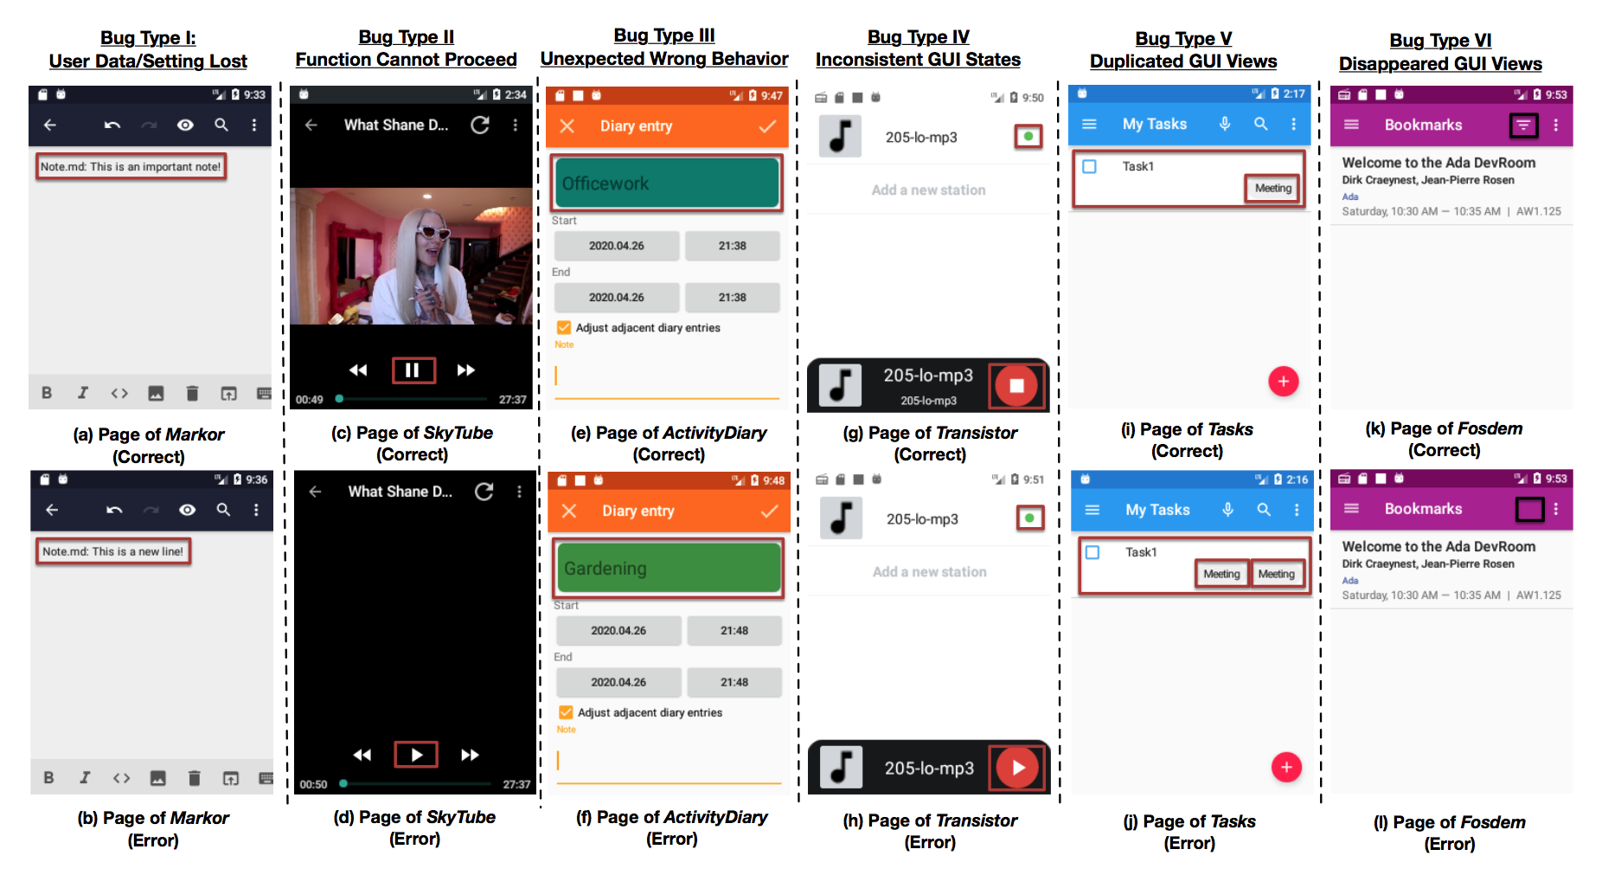

Slide 109
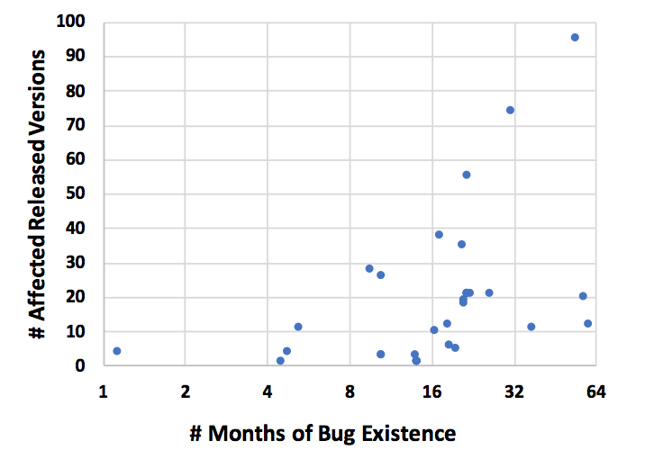
RQ4: Bug Types/Characteristics
12

Slide 110
RQ4: Bug Types/Characteristics
A Bug
12

Slide 111
RQ4: Bug Types/Characteristics
26 out of 34 bugs (78.8%) were unnoticed for more than one year.
12

Slide 112
RQ4: Bug Types/Characteristics
19 out of 34 bugs (57.6%) affected more than 10 app releases.
12

Slide 113
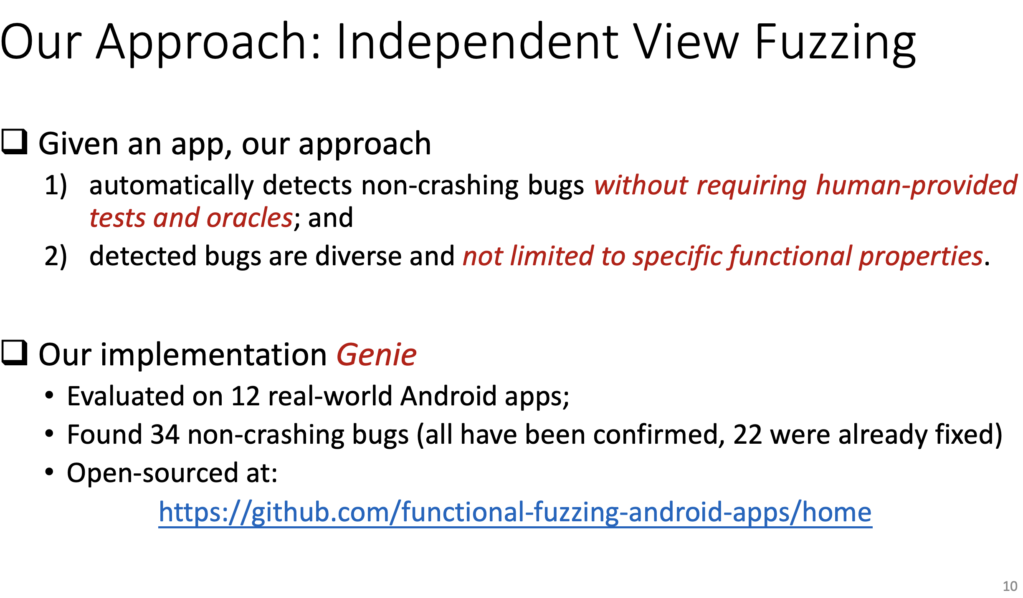
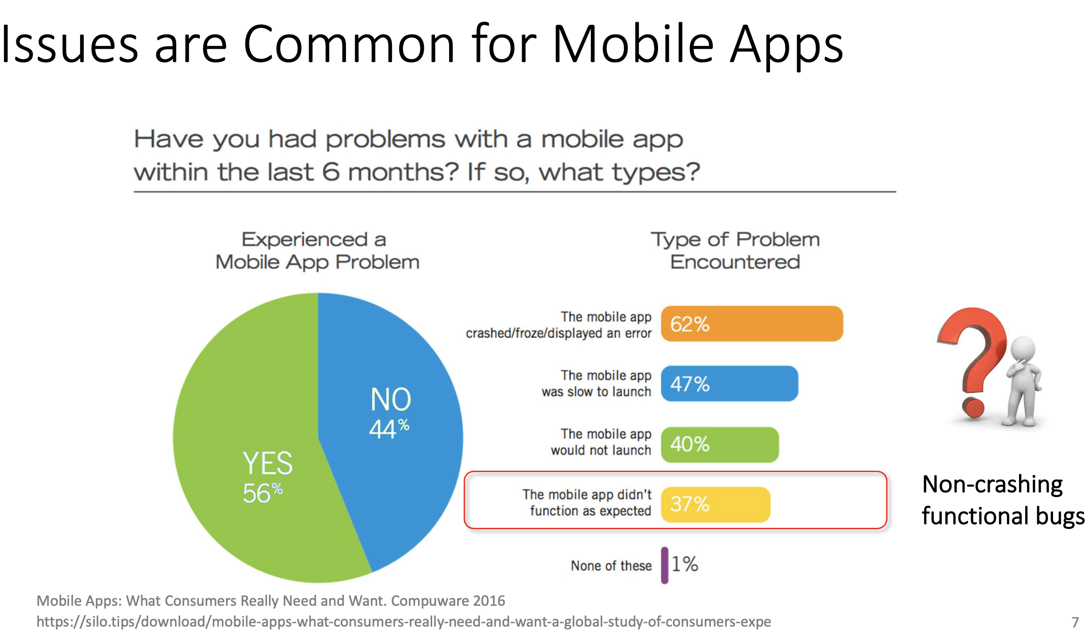
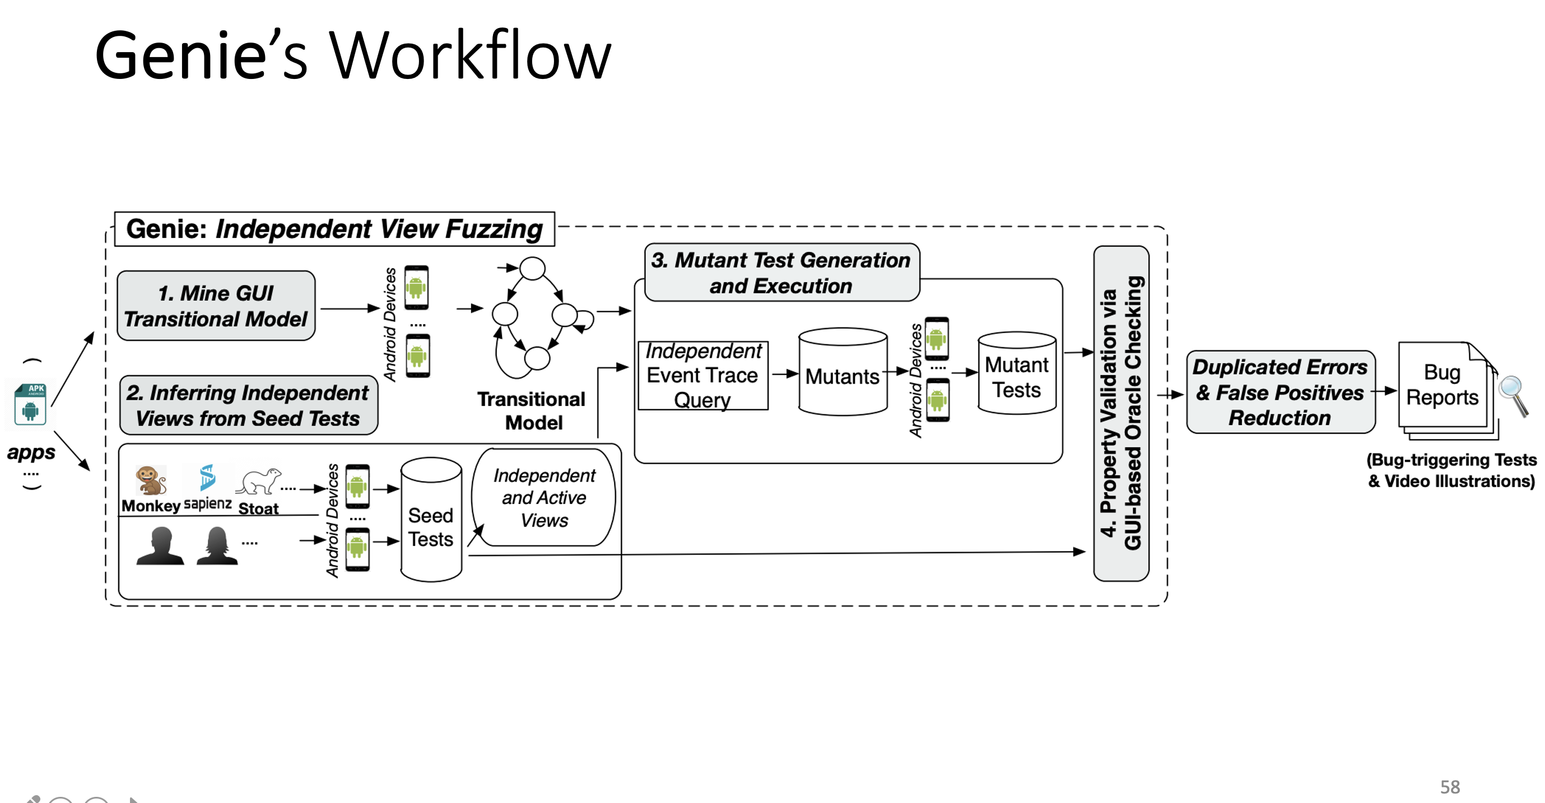
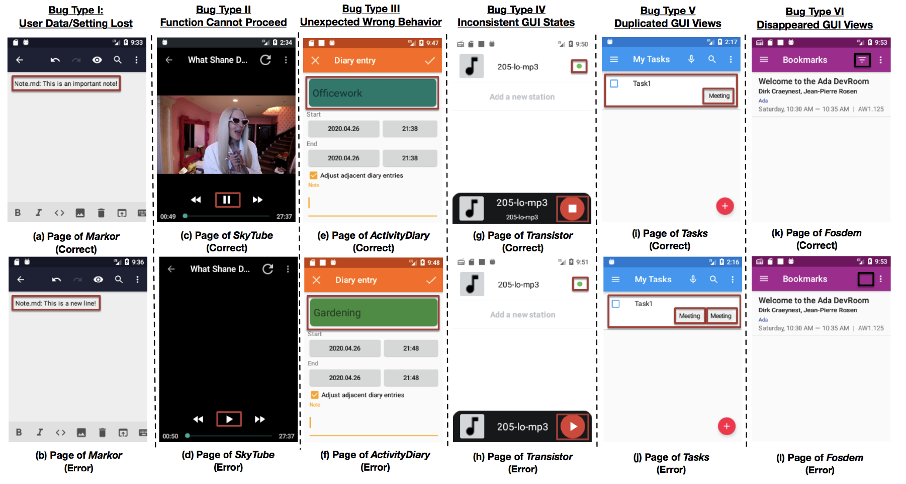
Wrap Up

Slide 114
Wrap Up

